Slide 1
Google Map API
Munir Uddin Ahmed
munir@muahmed.com

Slide 2
Objectives

Slide 3
Session -1
Get basic idea about Google Map API
Types of API
Google API Key
Draw a basic map
Map Overlays
Basic idea of loading and saving data

Slide 4
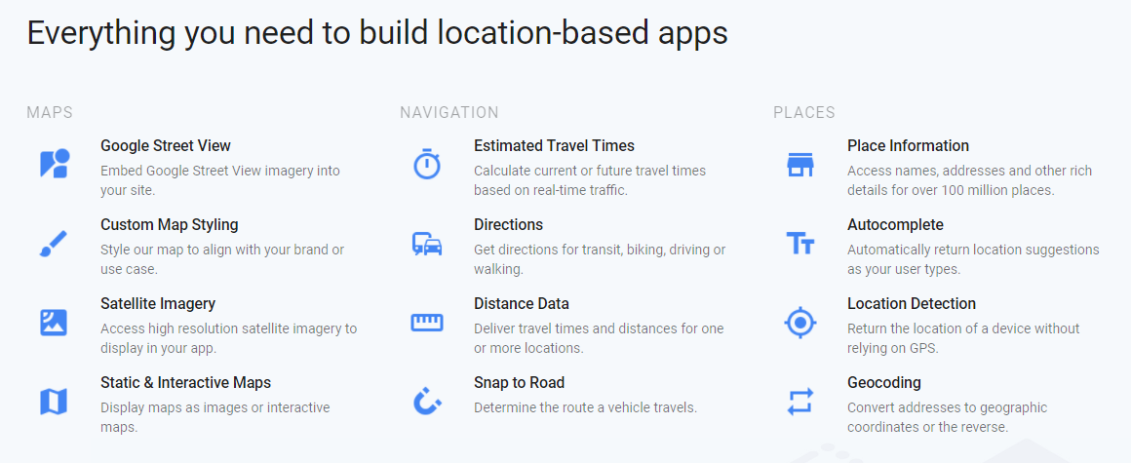

Slide 5
Types of API
https://developers.google.com/maps/
Web
Android
iOS
Web Service

Slide 6
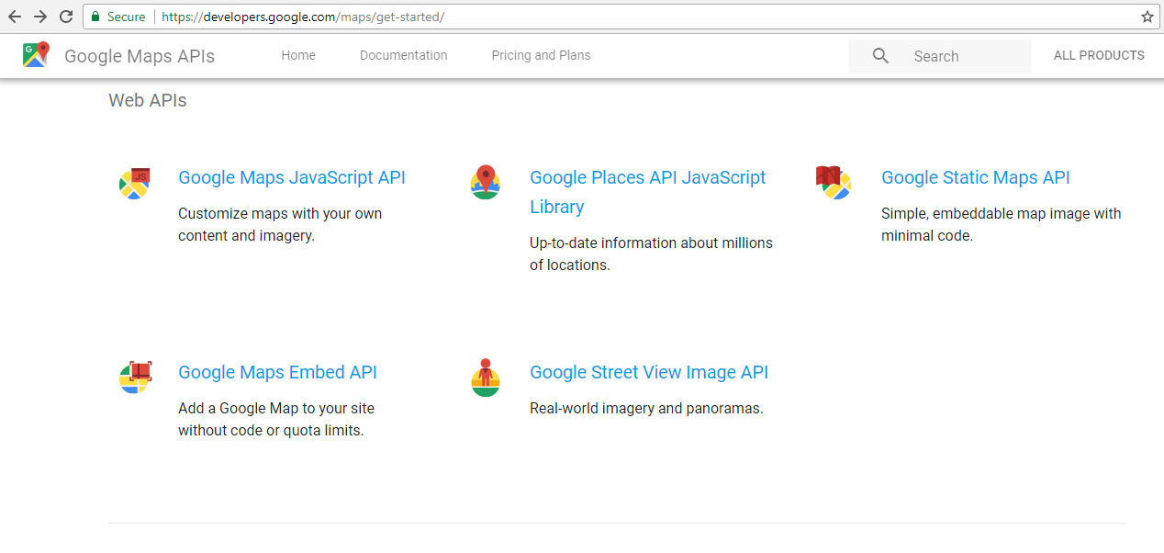

Slide 7
API Key
https://console.developers.google.com
Free or Paid
Know the limits of free.

Slide 8
A Minimal Map
<script src="https://maps.googleapis.com/maps/api/js?key=YOUR_KEY&callback=YOUR_CALLBACK">
</script>
function showMap() { var mapProp= { center:new google.maps.LatLng(23, 90), zoom:5, }; var map=new google.maps.Map(document.getElementById(“YOUR_DIV"), mapProp); }

Slide 9
Overlays
Overlays are objects on the map that are bound to latitude/longitude coordinates.
Google Maps has several types of overlays:
Marker - Single locations on a map. Markers can also display custom icon images
Polyline - Series of straight lines on a map
Polygon - Series of straight lines on a map, and the shape is "closed"
Circle and Rectangle
Info Windows - Displays content within a popup balloon on top of a map
Custom overlays

Slide 10
Adding a marker
var marker = new google.maps.Marker({
position: new google.maps.LatLng(23, 90),
map: Map
});
Or
var marker = new google.maps.Marker({position: myCenter}); marker.setMap(myMap);

Slide 11
API Documentation
https://developers.google.com/maps/documentation/javascript/

Slide 12
